Slide 1
Microservices
Pravin Y Pawar

Slide 2
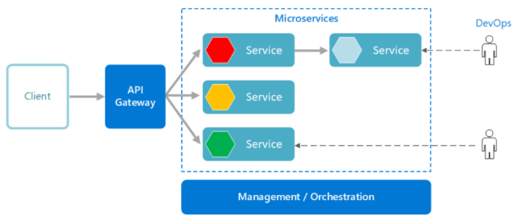
Microservices architecture style
A microservices architecture consists of a collection of small, autonomous services
Each service is self-contained and should implement a single business capability
Source Image : Microsoft

Slide 3
What are microservices?
Small, independent, and loosely coupled
A single small team of developers can write and maintain a service.
Each service is a separate codebase
can be managed by a small development team.
Services can be deployed independently
A team can update an existing service without rebuilding and redeploying the entire application
Services are responsible for persisting their own data or external state
Services communicate with each other by using well-defined APIs
Internal implementation details of each service are hidden from other services
Services don't need to share the same technology stack, libraries, or frameworks

Slide 4
Characteristics
Multiple Components
Software built as microservices can, by definition, be broken down into multiple component services
Reason
Each of these services can be deployed, tweaked, and then redeployed independently without compromising the integrity of an application
As a result, one might only need to change one or more distinct services instead of having to redeploy entire applications
Downsides,
Expensive remote calls (instead of in-process calls)
coarser-grained remote APIs
increased complexity when redistributing responsibilities between components

Slide 5
Characteristics (2)
Built For Business
The microservices style is usually organized around business capabilities and priorities
Unlike a traditional monolithic development approach
where different teams each have a specific focus on,
UIs, databases, technology layers, or server-side logic — microservices architecture utilizes cross-functional teams
The responsibilities of each team are to make specific products based on one or more individual services communicating via message bus
In microservices, a team owns the product for its lifetime
as in Amazon’s oft-quoted maxim “You build it, you run it”.

Slide 6
Characteristics (3)
Decentralized
Since microservices involve a variety of technologies and platforms
old-school methods of centralized governance aren’t optimal
Decentralized governance is favored by the microservices community because
its developers strive to produce useful tools that can then be used by others to solve the same problems
Just like decentralized governance
microservice architecture also favors decentralized data management
Monolithic systems use a single logical database across different applications.
In a microservice application, each service usually manages its unique database.

Slide 7
Characteristics (4)
Failure Resistant
Microservices are designed to cope with failure.
As several unique and diverse services are communicating together
quite possible that a service could fail, for one reason or another
e.g., when the supplier isn’t available
Here, client should allow its neighboring services to function while it bows out in as graceful a manner as possible
Monitoring microservices can help prevent the risk of a failure
For obvious reasons, this requirement adds more complexity to microservices as compared to monolithic systems architecture.

Slide 8
Thank You!
References:
Microservices architecture style
Microsoft Architecture Guide
Microservices by SmartBear
In our next session:

